Slide 1

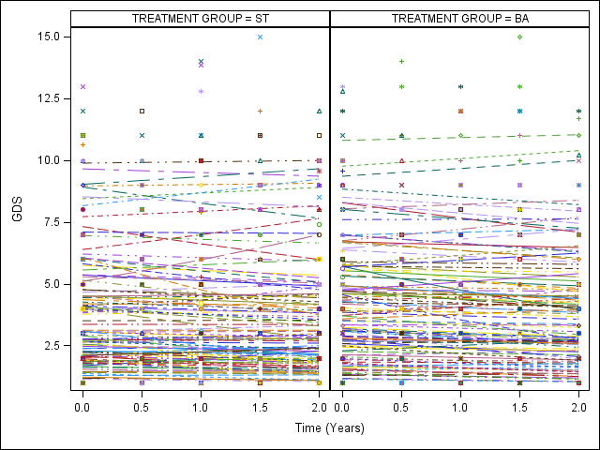
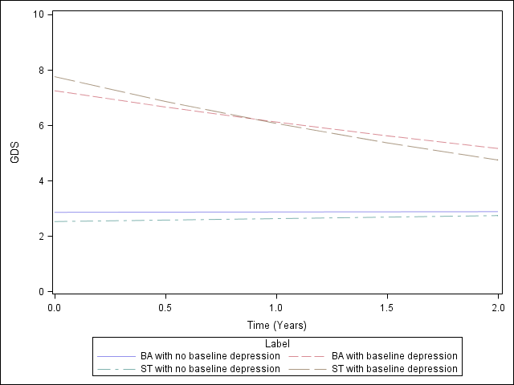
Assessing the Impact of Behavioral Activation on
Depressive Symptoms in Blacks with Mild Cognitive Impairment
Ha Nguyen, Dr. Robin Casten⁽¹⁾, Dr. Barry Rovner⁽²⁾, Dr. Benjamin Leiby⁽³⁾
⁽¹⁾Departments of Psychiatry and Human Behavior, ⁽²⁾Department of Psychiatry, Neurology, and Ophthalmology,
⁽³⁾ Division of Biostatistics, Department of Pharmacology and Experimental Therapeutics
Introduction
Results
Discussion
African Americans are at higher risk of dementia than Whites, and depression is a common comorbid condition of cognitive impairment (Alzheimer’s Association, 2018; Pellegrino et al., 2013).
Behavioral Activation (BA) has been shown to be effective in treating depression, but few studies have looked at its efficacy in preventing cognitive decline (Chartier & Provencher, 2013).
A 2-year randomized controlled trial suggested that BA prevented cognitive decline in Blacks with Mild Cognitive Impairment (Ronver et al., 2018).
To further examine the effects of BA on the comorbid depression (secondary outcome) of the trial, this study investigated whether BA was more effective in decreasing depressive symptoms than the control treatment.
Increased education, literacy and cognitive function were found to be associated with decreased baseline GDS score. Higher chronic disease, financial difficulty and diabetes were associated with increased baseline depression.
Overall, neither Behavioral Activation nor Supportive Therapy reduced depressive symptoms in Blacks with Mild Cognitive Impairment over 2 years. Participants with suggestive depression in both groups improved over time.
The results suggest that BA may not be more effective than ST in treating depression in Blacks with MCI.
The odds of suggestive depression at baseline was higher for ST participants (result not shown), however, the odds increase in BA while decreasing in ST (table 2). This result, however, was not statistically significant.
There was a higher attrition rate in the BA group. This different attrition rate by treatment group suggests that missing data might be missing not at random (MNAR).
Linear mixed effects model suggests that the rate of decrease in GDS score was not significantly different between the two treatment groups (p=0.84), indicating no effect of treatment on GDS trajectory over 2 years.
Research Questions
Figure 1. Individual fitted slopes of GDS score over time by treatment group
Was the effect of Behavioral Activation (BA) on depressive symptoms in Blacks with Mild Cognitive Impairment (MCI) different than that of Supportive Therapy (ST) over the 2-year period?
Participants with suggestive baseline depression (GDS ≥ 6) in both groups had significantly reduced depressive symptoms over time (BA: p=0.023 , ST: p <0.01. There is little evidence of moderation of treatment effect by different baseline depression status (p=0.3). We found no effect-moderation of financial status, cognitive function and health status.
Future Directions
Future analysis could use joint modeling under the MNAR assumption to test for the sensitivity of our current results.
Materials and Methods
221 Blacks 65 years and older with amnestic Mild Cognitive Impairment were randomized to: Behavioral Activation (BA) and Supportive Therapy (ST).
References
Figure 2. Fitted slopes of GDS score over time by treatment group and baseline depression
2018 Alzheimer's disease facts and figures. Alzheimer's & Dementia: The Journal of the Alzheimer's Association. 4(3), 367 - 429
Pellegrino, L. D., Peters, M. E., Lyketsos, C. G., & Marano, C. M. (2013). Depression in cognitive impairment. Current psychiatry reports, 15(9), 384.
Rovner BW, Casten RJ, Hegel MT, Leiby B. (2018). Preventing Cognitive Decline in Black Individuals With Mild Cognitive Impairment A Randomized Clinical Trial. JAMA Neurol. doi:10.1001/jamaneurol.2018.2513
Soucy Chartier, I. & Provencher, M. (2012). Behavioural activation for depression: Efficacy, effectiveness and dissemination. Journal of affective disorders. 145. 10.1016/j.jad.2012.07.023.
Characteristics | Total (N = 221) | BA (N = 111) | ST (N = 110)
Age - year | 75.82 ± 6.99 | 75.49 ± 7.11 | 76.15 ± 6.89
Female sex – number (%) | 175 (79.19) | 89 (80.18) | 86 (78.18)
Baseline GDS |  | 3.67 ± 3.12 | 3.23 ± 3.02
Logistic mixed effects regression was used to model the odds of having suggestive depression between two groups at any given time. There is very little evidence that the change in the risk of suggestive depression from baseline was significantly different between BA and ST at any follow-up time points (all p > .05).
Table 1. Baseline characteristics by treatment group
Time | Odds ratio Change from Baseline BA | Odds ratio Change from Baseline ST | p-value of odds ratio difference in change
Baseline | - | - | -
6 months | 0.92 | 0.64 | 0.56
12 months | 1.17 | 0.54 | 0.23
18 months | 1.26 | 0.44 | 0.11
24 months | 1.67 | 0.65 | 0.14
The BA group had 6 in-home sessions with nurses to set goals to engage in physical, cognitive and social activities. The ST group had 6 in-home sessions in which participants were encouraged to freely express their personal thoughts (no active treatment).
Depressive symptoms were measured at baseline, 6, 12, 18 and 24 months using the Geriatric Depression Scale (GDS). Baseline demographic and clinical characteristics were also collected.
Acknowledgements
Thank you to Dr. Robin Casten and Dr. Ben Leiby for their psychology and statistical expertise. Thank you to Jefferson University’s Division of Biostatistics for sponsoring this research project.
Table 2. Odds ratio change from baseline of GDS ≥ 6 at each time point for an “average” participant

